Slide 1
Introduction to scripts and tutorial on running FBIT assessment in R
https://github.com/ices-eg/FBIT/tree/dev

Slide 2
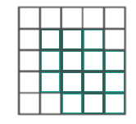
Four steps for the workflow:
2. Estimate relationships between longevity and environment from benthic data
3. Predict sensitivity (=longevity distribution) at large spatial scales
4. Estimate seabed state for the whole region and per MSFD habitat type
1. Assign region of interest

Slide 3
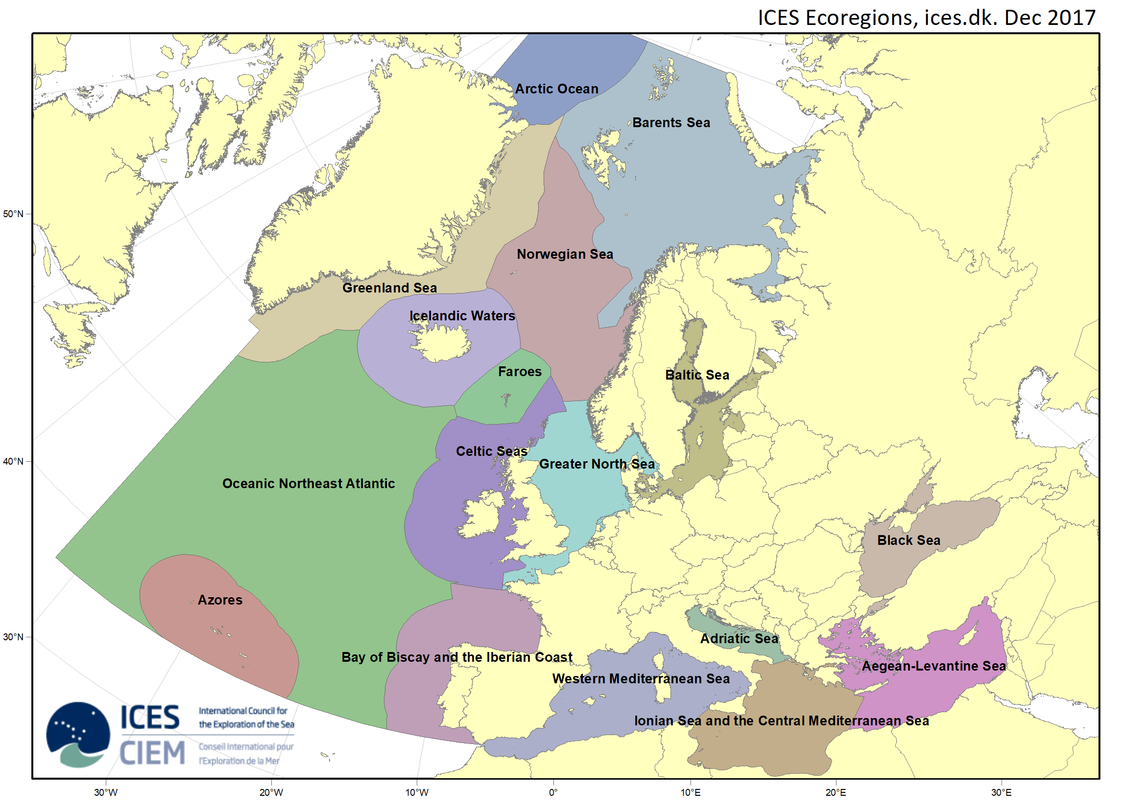
Step 1: Assign region of interest

Slide 4
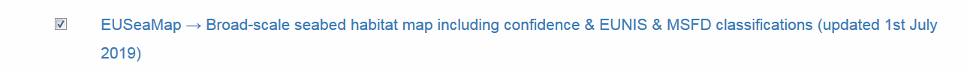
Step 1: Assign region of interest: data layers
EMODNET MSFD habitats (large datafile)
https://www.emodnet-seabedhabitats.eu/access-data/download-data/?linkid=1
ICES Ecoregions
http://gis.ices.dk/shapefiles/ICES_ecoregions.zip
Exclusive Economic Zones
www.marineregions.org/download_file.php?name=EEZ_land_union_v2_201410.zip
OSPAR Reporting Units (or equivalent in Mediterranean (GFCM) / Baltic (HELCOM habitats)
https://odims.ospar.org/documents/62
Download any other data layer of interest to your region (e.g. Baltic Sea -> Salinity)
……

Slide 5

Step1_region.R in the folder: Step 1 Assign region of interest

Slide 6
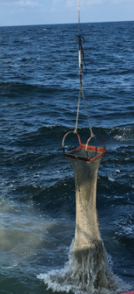
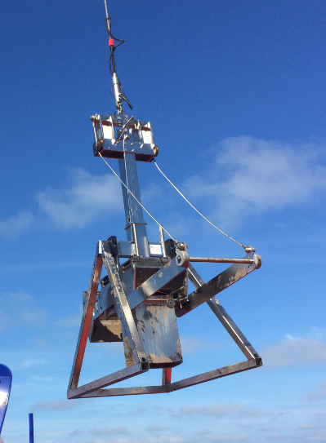
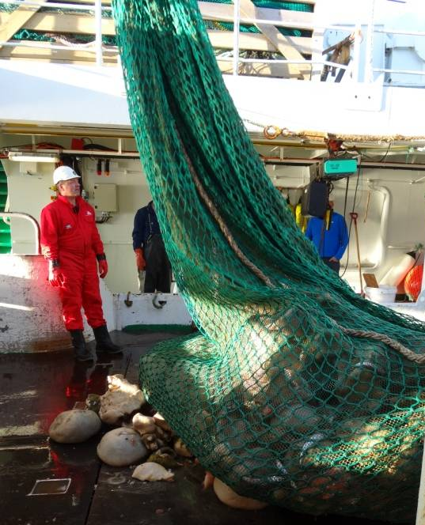
Step 2: Estimate relationships between longevity and environment from benthic data
Data requirements:
Benthic sampling data (preferably unfished locations); infauna / epifauna / megafauna
Longevity datatable per species / genus / family

Slide 7
Step 2. Longevity data table
Longevity data tables are available, e.g.:
CEFAS/BENTHIS -- Stef Bolam (infauna/epifauna)
IMR/HCMR -- Lene Buhl Mortensen (megafauna)
EMODNET -- Olivier Beauchard (infauna/epifauna)
We urge users to go through the info for the taxa listed on their spreadsheet and check as far as practicably possible rather than assuming that all info contained is reliable. Inaccuracies may also creep in due to geographical or even more regional differences.

Slide 8

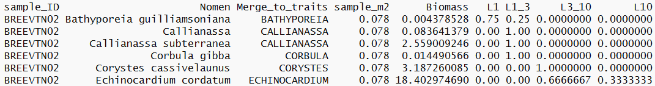
Step 2: Longevity per station
Longevity is here assigned in 4 categories (using BENTHIS trait data table)
< 1 year
1-3 years
3-10 years
> 10 years
Example:

Slide 9
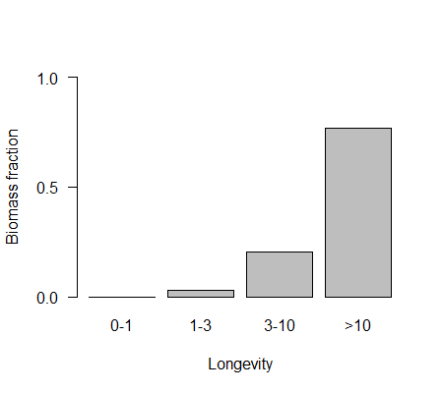
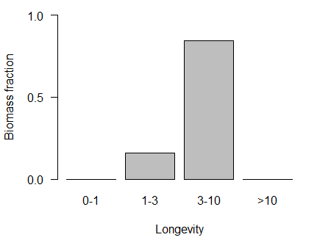
Benthic sampling data with longevity
For each sampling station, we can describe the distribution of biomass across the longevity classes
Example station A
Example station B

Slide 10
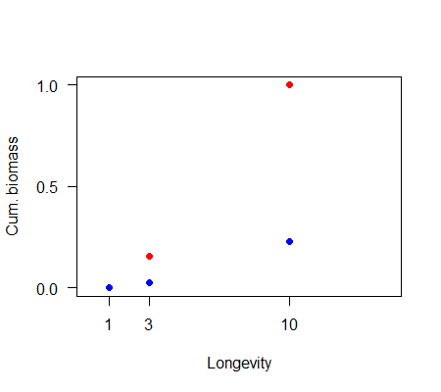
Step 2: From categorical to continuous distribution
Example station A
Fit a statistical model to predict variation in longevity as a function of the environment
Example station B

Slide 11
Statistical model
We assume that the biomass proportion at each station is a sigmoidal (logistic) function of longevity (Fig. 3), which starts at 0 and approaches 1 when longevity becomes large
Model specifications:
Longevity is log transformed
Mixed model with binomial distribution
Mixed model with sampling station as random variable (normal distribution)
Purpose is to predict (extrapolate) longevity for each grid cell

Slide 12
Step 2 Estimating longevity benthic data.R in the folder: Step 2 Estimate relationships benthic data

Slide 13
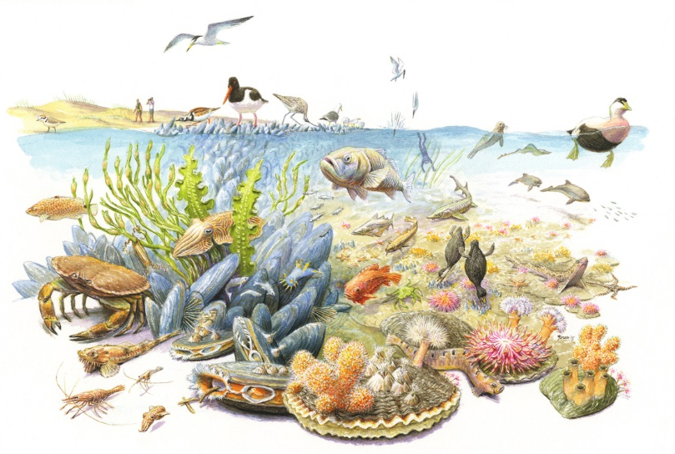
Step 3. Predict sensitivity (=longevity distribution) at large spatial scales
Requirements:
Success in step 1 and 2

Slide 14

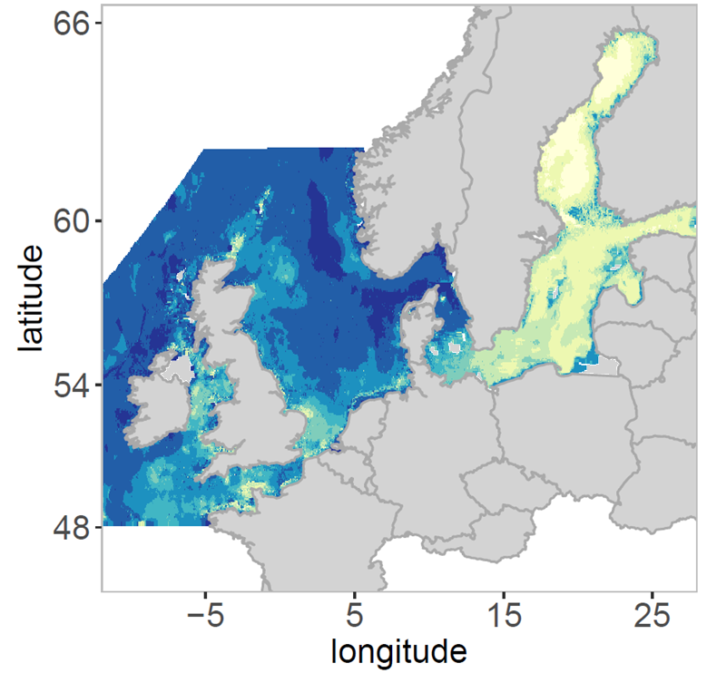
Step 3. Predict sensitivity (=longevity distribution) at large spatial scales
Similar environmental
conditions
Similar environmental
conditions

Slide 15
Step 3 Estimating sensitivity.R in the folder: Step 3 Predict sensitivity

Slide 16
Step 4. Estimate seabed state for the whole region and per MSFD habitat type
Requirements:
Bottom trawl fishing intensities (ICES WGSFD) (for now random data)
Parameterization:
Recovery rate is longevity dependent (Hiddink et al. 2017)
Depletion rate is gear-dependent (OT, TBB, TD) (Hiddink et al. 2016)

Slide 17
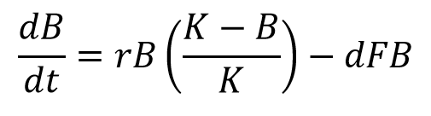
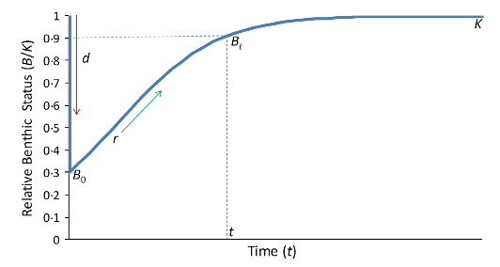
Logistic growth equation

Slide 18
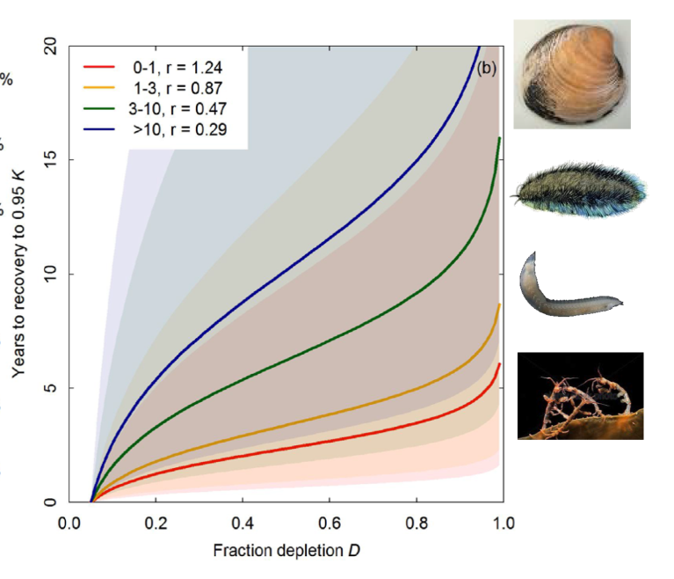
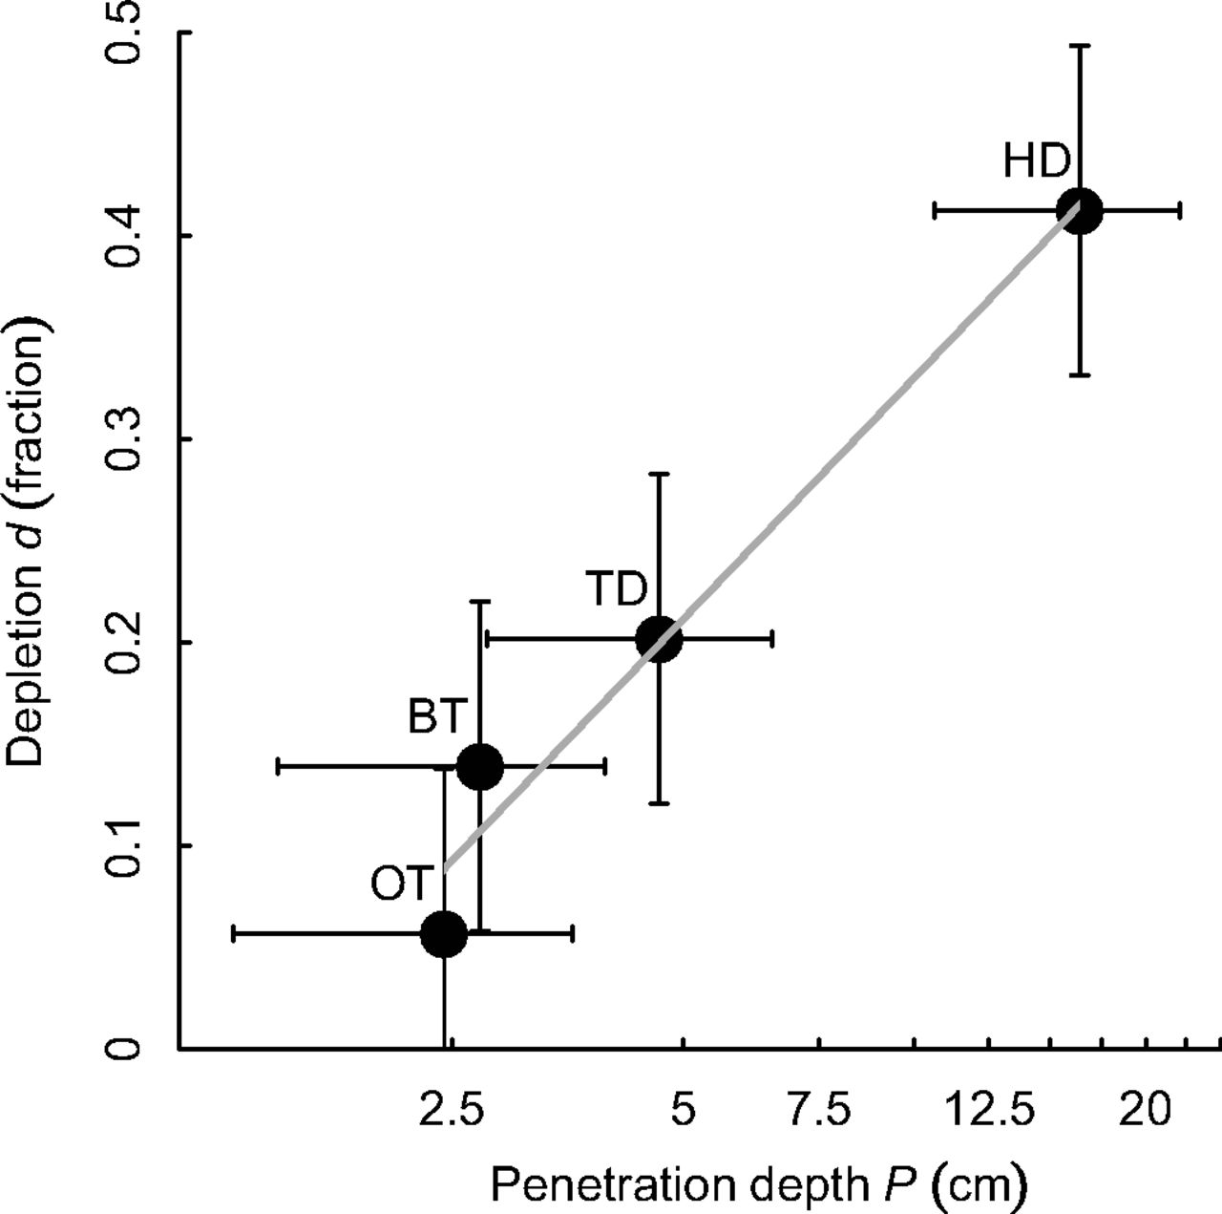
Step 4. Estimate seabed state for the whole region and per MSFD habitat type
Recovery rate depends on the longevity distribution (Hiddink et al. 2017)
Depletion rate is gear dependent (Hiddink et al. 2016)

Slide 20
Step 4 calculate impact.R in the folder: Step 4 Calculate impact

